Slide 1

Automated Unit Testing with Jasmine
Test-driven development and how to implement it with JavaScript
Breakout example:
Https://github.Com/seanyoung247/breakout

Slide 2
Test driven development
What is test driven development?
A software development process
Emphasises application requirements
Defines tests before implementation
Why use test-driven development?
Promotes simple and focused code
Promotes cleaner and clearer code
Promotes good design and modularity
Ensures code is correct immediately

Slide 3
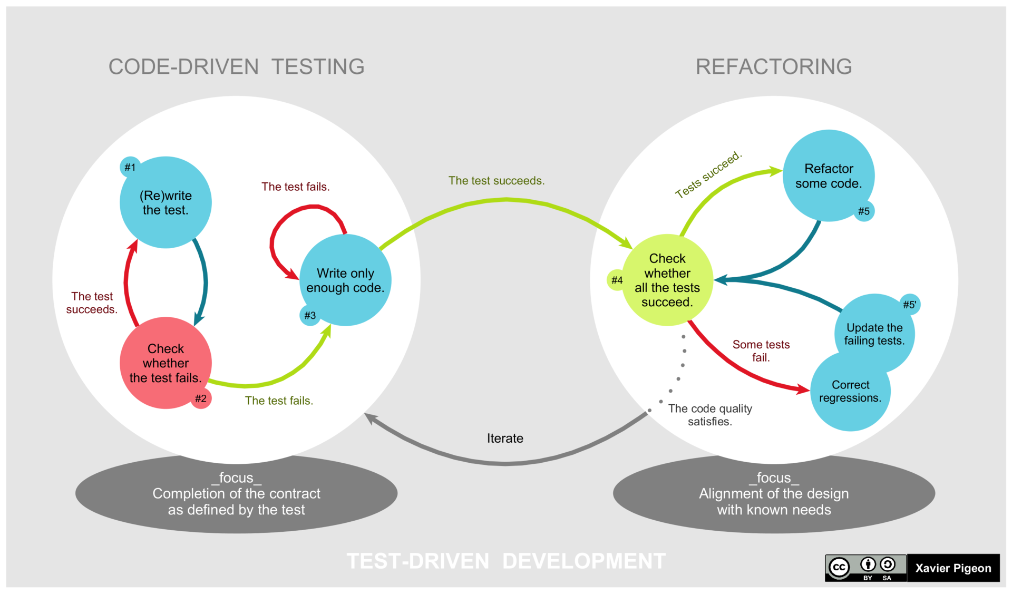
Implementing test Driven Development
Define requirements
Add a test
Run all tests
Add simple code
Run all tests
Finalise implementation
Repeat

Slide 4
Automated Unit testing
Automated
Breaks code down into units
Tests each unit in isolation
Ensures each component is correct
Aids documentation
Helps with code reuse

Slide 5
Unit testing in JavaScript
Usually implemented through frameworks
Jasmine is a comprehensive and popular framework
Jasmine is ”batteries included”
Has no dependencies
Can be run from a browser
Is behavior driven

Slide 6
Setting up Jasmine
Can be used locally, from CDN or Node.js
CDN:
Links can be obtained from cdnjs: https://cdnjs.com/libraries/jasmine
Local:
Jasmine releases can be obtained from github: https://github.com/jasmine/jasmine/releases

Slide 7
Setting up Jasmine
Add Jasmine files to project (if using locally)
Create a test.html file
Add Jasmine files
jasmine.js - Main jasmine code
jasmine-html.js - Generates html for use in a browser
boot.js - Sets up the jasmine framework
jasmine.css - Styling for the generated html.
Add spec scripts
Add source script files

Slide 8
Setting up Jasmine
Test html Structure
<!DOCTYPE html>
<html lang="en" dir="ltr">
<head>
<meta charset="utf-8">
<!-- Jasmine Framework includes -->
<!-- /Jasmine Framework -->
</head>
<body>
<!-- Source files -->
<!-- Test files -->
</body>
</html>
<script src="jasmine.js"></script>
<script src="jasmine-html.js"></script>
<script src="boot.js"></script>
<link rel="stylesheet" href="jasmine.css"/>
Jasmine framework files
Your JavaScript source files
<script src="assets/js/test.js"></script>
Test scripts
<script src="spec/testSpec.js"></script>

Slide 9
Setting up Jasmine
File Structure
Project Root
libs
Local Jasmine install (if using)
spec
test.html
spec JavaScript files

Slide 10
Jasmine Test Suite
describe(“Component”, function() {
});
let testComponent;
beforeEach(function() {
testComponent = new Component(5);
});
toBe() – Checks the value is the same (==)
toEqual() – Checks strict equality (===)
toBeCloseTo() – Checks value is close to
toBeTrue/False() – Boolean checks
ToBeTruthy/Falsey() – Boolean like values
toThrowError() – Checks that an exception is thrown
toHaveBeenCalled() – ensures a function is called
Negated with not()
it(“is created with correct values”, function() {
});
it(“returns the correct values”, function() {
});
expect(testComponent.value).not.toBe(10);
expect(testComponent.method()).toBeCloseTo(1.2);
describe(“method”, function() {
});

Slide 11
Isolating Components - Spies
it(“should make string uppercase”, function() {
let upperSpy = spyOn(String.prototype, "toUpperCase”).and.callThrough();
expect(someFunction()).toBe(“RETURN VALUE”);
// Simple check that the function was called
expect(String.prototype.toUpperCase).toHaveBeenCalled();
// Checks the function was called the correct number of times
expect(upperSpy.calls.count()).toEqual(1);
});
spyOn(String.prototype, “toLowerCase”).and.returnValue(“fake string”);
spyOn(String.prototype, “toLowerCase”).and.fakeCall(function() {return “fake string”;});

Slide 12
Isolating Components - Mocking
let mockObj = jasmine.createSpyObj(“realObj”, [“method1”, “method2”]);
let mockObj = jasmine.createSpyObj(
“realObj”, [“method1”, “method2”],
{property: 10}
);
mockObj.method2.and.returnValue(15);
mockObj.method1.and.callFake(function() {return 10;});

Slide 13
Putting it together: Breakout
Game
-canvas
-thisFrameTime
-lastFrameTime
-actionMap
-keyMap
-lives
-score
-won
-bounds
-paddle
-ball
-blocks
-startFrame()
-checkVictory()
-update()
-drawFrame()
-endFrame()
+loseALife()
+increaseScore()
+loop()
+keyDown()
+keyUp()
+mouseMove()
Block
-alive
+draw()
+collision()
AbstractClass
-baseClass
+AbstractMethod()
Point2D
-x
-y
+distanceTo()
Paddle
-speed
+draw()
+collision()
+moveLeft()
+moveRight()
+setPos()
BoundingBox
-width
-height
+inbounds()
+collides()
+contains
GameObject
-game
-boundingBox
+draw()
+collision()
Ball
-vector
+draw()
+collision()
+move()
Vector2D
+normalize()
+magnitude()
+radian()
+rotate()

Slide 14
Questions?
Further Reading
Test-driven development
https://en.wikipedia.org/wiki/Test-driven_development
Unit Testing
https://en.wikipedia.org/wiki/Unit_testing
Jasmine Documentation
https://jasmine.github.io/pages/docs_home.html
https://jasmine.github.io/tutorials/your_first_suite

